Slide 1
RFID CONTROLLED AUTOMATED PATH ROBOT
SRM INSTITUTE OF SCIENCE AND TECHNOLOGY, RAMAPURAM DEPARTMENT OF ELECTRONICS AND COMMUNICATION ENGINEERING MAJOR PROJECT 18ECP104L
GUIDE NAME :- Mrs.AARTHI ELAVENI (ASST PROFESSOR)
DONE BY : ESWAR S (RA2011004020123)
CHIMMANA VIKAS (RA2011004020090)
VIVEK C ( RA2011004020134)

Slide 2

ABSTRACT
The majority of maps used for mobile robot path planning are grid maps, which are produced by modeling after independent design or sensor measurement to gather pertinent data. The project focuses on applying RFID technology to enable precise control over a robotic system's movements in order to obtain the robot's motion planning path more quickly. Real-time communication and guidance are enabled through the communication of RFID tags embedded within the robot with RFID readers strategically positioned along predefined paths. With the help of this integration, the robot can now navigate tricky terrain or pre-designated routes without the need for human assistance.

Slide 4
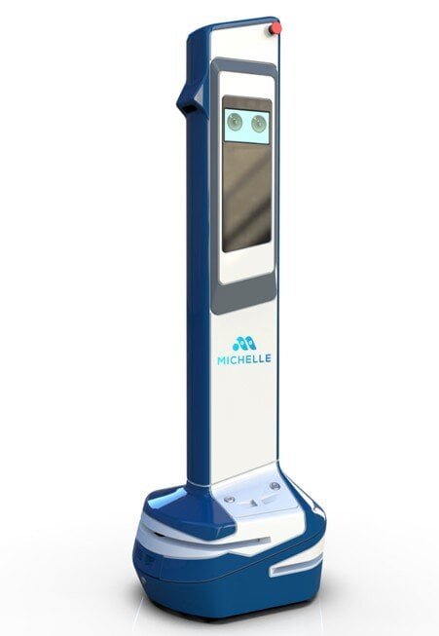
INTRODUCTION
Autonomous navigation is an essential component of many industries in today's technological landscape, such as smart infrastructure, logistics, and manufacturing. For robotics, the application of RFID technology offers a viable means of accurate and effective path control. The goal of this project is to create a robotic system that can precisely follow predetermined routes by using tags and RFID readers. The system gains the ability to recognize and decipher RFID tags strategically positioned along the intended route by integrating RFID technology. The robot can follow predefined paths, modify its movements, and possibly even make decisions based on the data it receives from the RFID tags thanks to this communication.
.
FIG 1.1

Slide 5
INRODUCTION
This project aims to develop a robotic system that uses RFID technology for accurate path control in industries like smart infrastructure, logistics, and manufacturing. The system recognizes and deciphers RFID tags, allowing the robot to follow predetermined paths, modify its movements, and make decisions. Applications requiring automated and controlled movement, like transportation, surveillance, and warehouse management, stand to benefit greatly from the integration of RFID-controlled navigation. The purpose of this project is to investigate whether RFID technology can improve the precision and autonomy of robotic navigation systems. With this project, we hope to demonstrate the robotics potential of RFID-based control systems, which provide a creative and effective method of autonomous path navigation for a range of real-world uses.

Slide 6
LITERATURE SURVEY:
SI.NO | AUTHOR | YEAR | MERITS | DEMERITS
1 | Alessandro Luz(RFID automatic labeler for Item level) | 2023 | a simple and cheap motor is used inthe proposed autonomous mobile vehicle. | The material and capability requirements of RFID technology are complex and expensive
2 | Ahed Abugabah (RFID Adaption in Healthcare Organizations: An Integrative Framework ) | 2021 | focuses on individual factors as well as organizational and technological factors in order to better understand the phenomenon of RFID adoption in healthcare | Passive tags are cheaper. Due to the high cost of active tags and their maintenance, they are often limited to more expensive mobile assets
3 | Hugo Landaluce ( IoT Sensing Applications and Challenges Using RFID and Wireless Sensor Networks) | 2020 | RFID systems are able to identify and track devices, whilst WSNs cooperate to gather and provide information from interconnected sensors | It cannot be used in high speed communication as it is designed for low speed application. there are the efficiency of the energy harvesting

Slide 7
HARWARE REQUIREMENT:
Microcontroller
RFID Reader & Tag
Motor driver
Dc motor
9V Battery
SOFTWARE REQUIREMENT:
Arduino ide
Embedded c

Slide 8
Microcontroller:
Integrated Circuit (IC): A microcontroller is an IC designed to control other components within an electronic system. It typically includes a microprocessor unit (MPU), memory, and various peripherals12.
Program Memory: This stores the program instructions (code) that the microcontroller executes. Common types include ferroelectric RAM, NOR flash, or OTP ROM.
Peripherals: Microcontrollers come with programmable input/output peripherals, allowing them to interact with external devices. These peripherals can include timers, analog-to-digital converters, communication interfaces (such as UART, SPI, or I2C), and more.
Low Power Consumption: Microcontrollers can operate at very low power levels, making them suitable for battery-powered applications. They can retain functionality while waiting for specific events (such as button presses) with minimal power consumption.
Edge Devices in IoT: In the context of the Internet of Things (IoT), microcontrollers serve as economical and popular means for data collection, sensing, and actuating the physical world at the edge.

Slide 9
RFID READER & TAG
Inductive Coupling: The reader uses inductive coupling to communicate with passive RFID tags. When a tag is brought close to the reader, it receives power from the reader’s electromagnetic field and responds with its stored information.
Data Retrieval: The reader decodes the information stored in the tag and passes it to an application system.
Integration: RFID readers can be integrated into various hardware designs due to their compact size.
Passive Tags: These tags do not have their own power source. They derive power from the reader’s electromagnetic field during communication.
Active Tags: Active tags have their own power source (usually a battery) and can transmit data over longer distances.

Slide 10
Arduino IDE
1. Integrated Development Environment (IDE): The Arduino IDE provides a user-friendly interface for writing, compiling, and uploading code to Arduino boards.
2. Cross-Platform Compatibility: Available for Windows, macOS, and Linux operating systems, making it accessible to a wide range of users.
3. Code Editor: The IDE features a simple yet powerful code editor with syntax highlighting and auto-completion, facilitating code writing and editing.
4. Library Manager: It includes a Library Manager tool that allows you to easily browse, install, and manage libraries for extending the functionality of your Arduino projects.
5. Board Manager: The Board Manager simplifies the process of adding support for different Arduino-compatible boards, including official Arduino boards and third-party variants.
6. Serial Monitor: A built-in Serial Monitor tool enables real-time communication with the connected Arduino board, facilitating debugging and data visualization

Slide 11
Embedded C :
Embedded C is used to program a wide range of microcontrollers and microprocessors.
It requires fewer resources to execute compared to high-level languages like assembly.
Embedded C includes additional data types and keywords specific to embedded systems.
It allows interaction with hardware devices such as sensors and input-output peripherals.
Various Embedded C compilers (e.g., Keil Compiler, SPJ Compiler, Embedded GNU C Compiler) are available for compiling embedded C programs.
Devices we encounter daily, like air conditioners, printers, and mobile phones, are often programmed using embedded C.

Slide 12
EXISTING SYSTEM:
Traditional techniques like pre-programmed routes, proximity detectors, and computer vision systems were the mainstays of automated path control for robots.
These systems often faced limitations in adaptability and real-time adjustments.
Pre-programmed routes restricted the robot's flexibility, while proximity detectors lacked the granularity for precise path control.
Computer vision systems struggled in complex environments with varying lighting conditions and obstacles.
The absence of robust real-time control mechanisms hindered the agility and adaptability required for dynamic environments.

Slide 13
PROPOSED SYSTEM
It integrates RFID readers strategically positioned along designated paths:
RFID tags embedded within the robot communicate with these readers, enabling real-time data exchange for precise navigation.
This system facilitates dynamic path adjustments based on RFID tag recognition, allowing the robot to follow predefined routes accurately.
The RFID technology provides granular control, enhancing the robot's adaptability in complex environments.
It seeks to provide a responsive, self-governing navigation system that can decipher RFID tags and use that information to make judgment calls.
accurate and efficient path traversal without the constraints of conventional pre-programmed routes or sensor-based navigation systems.

Slide 14
ADVANTAGES DISADVANTAGES
1.Precision in navigation 1. Limited adaptability
2.Real-time adaptability 2. Lack of precision
3. Reduced dependency on environment 3.Environmental dependency
4.Enhance Complexity in real-time 4.Improved efficiency
6.Lower maintenance required 5.Limited interactivity
7. Enhanced interactivity 6.Sensitivity and interference
8. Reliability and consistency

Slide 15
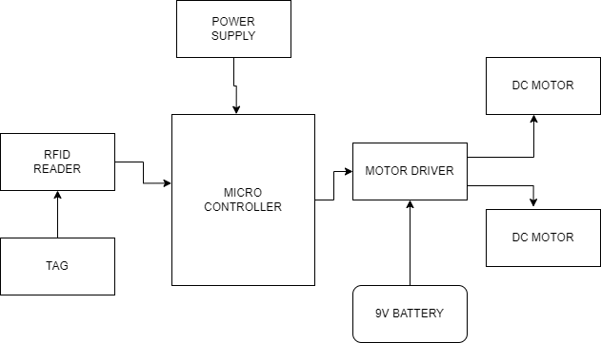
BLOCK DIAGRAM:
FIG 1.2

Slide 16
WORKING MECHANISM:
RFID (Radio-Frequency Identification) System:
The main Components of the RFID system is scanning antenna for RFID Reader emits radio waves and communicates with the RFID tags.
The RFID reader emits radio waves via the scanning antenna.
When an RFID tag enters the reader’s range, it receives power from the reader’s electromagnetic field.
The tag responds by transmitting its stored information back to the reader.
Communication occurs through radio waves, allowing data exchange between the reader and tag.
RFID technology operates on electromagnetic coupling, enabling wireless data transfer.
Pure Pursuit Algorithm: Used for steering control.
Soft Actor-Critic Algorithm: Trains a velocity control strategy.
The robot adapts its velocity to accommodate different path shapes.

Slide 17
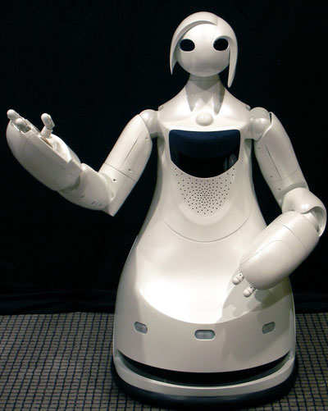
FUTURE SCOPE:
Integrations with Other Technologies: The flexibility of RFID tags enables smooth interaction with other technologies.The best aspects of the Internet of Things (IoT) and contemporary warehouse operations will be combined in the future with smart-sensing RFID solutions.
Increased Sustainability: RFID tags, readers, and antennas will merge with powerful IoT edge computing. Users will interact with these solutions using touch screens or other input devices.
Adaptive Navigation: These robots can adapt their paths based on real-time data. For example, if they detect signs of poaching (such as unusual movements), they can dynamically adjust their routes to investigate further.
Collaboration with Drones: Automated path robots can collaborate with drones for aerial surveillance. Drones equipped with RFID readers can scan large areas quickly, while ground robots cover specific trails.
FIG 1.3

Slide 18
CONCLUSION:
Robotic automated path control with RFID technology represents a major advancement in accurate navigation. Because the system can read RFID tags, it can make dynamic changes and be more flexible when following pre-planned paths. With its ability to provide dependable and effective autonomous navigation in challenging environments, this innovation has promise for use across various industries. The research shows how real-time, fine-grained control over path-following mechanisms can be achieved through RFID-based systems, which have the potential to completely transform robotics. This technology sets the stage for future developments in autonomous robotics and a wide range of applications by offering enhanced efficiency, lower maintenance costs, and better adaptability. It is a flexible and responsive solution.

Slide 19
REFERENCES:
W. Hou, Z. Xiong, C. Wang, and H. Chen, ‘‘Enhanced ant colony algorithm with communication mechanism for mobile robot path planning,’’ Robot Auto. Syst., vol. 148, Feb. 2022, Art. no. 103949, doi:10.1016/j.robot.2021.103949.
M. Zhao, H. Lu, S. Yang, and F. Guo, ‘‘The experience-memory Q-learningalgorithm for robot path planning in unknown environment,’’ IEEE Access,vol. 8, pp. 47824–47844, 2020, doi: 10.1109/ACCESS.2020.2978077.
J. Zhao, S. Liu, and J. Li, ‘‘Research and implementation of autonomous navigation for mobile robots based on SLAM algorithm under ROS,’’ Sensors, vol. 22, no. 11, p. 4172, May 2022, doi: 10.3390/s22114172.
C. Choe, S. Ahn, N. Doh, and C. Nam, ‘‘Reduction of LiDAR point cloud maps for localization of resource-constrained robotic systems,’’ IEEE Syst. J., vol. 17, no. 1, pp. 916–927, Mar. 2023, doi: 10.1109/JSYST.2022.3162926.

Slide 20
REFERENCES:
Jay Singh, Navjit Brar, Carmen Fong, The State of RFID Applications in Libraries, .Information Technology and Libraries” Chicago 25.1 (Mar 2006): 24-32.
A. Larsan Aro Brian, L. Arockiam and P. D. Sheba Kezia Malarchelvi , An IOT based secured smart library system with NFC based book tracking International Journal of Emerging Technology in Computer Science & Electronics (IJETCSE) ISSN: 0976-1353 Volume 11 Issue 5 –NOVEMBER 2014.p. 18-21.
L. Liu, B. Wang, and H. Xu, ‘‘Research on path-planning algorithm integrating optimization A-star algorithm and artificial potential field method,’’ Electronics, vol. 11, no. 22, p. 3660, Nov. 2022, doi: 10.3390/electronics11223660.
S. Wang, Z. Ren, and M. Wu, ‘‘Non-uniform input-based adaptive growing neural gas for unstructured environment map construction,’’ Appl. Sci., vol. 12, no. 12, p. 6110, Jun. 2022, doi: 10.3390/app12126110.

Slide 21
REFERENCES:
L. Yang, Q. He, L. Yang, and S. Luo, ‘‘A fusion multi-strategy marine predator algorithm for mobile robot path planning,’’ Appl. Sci., vol. 12, no. 18, p. 9170, Sep. 2022, doi: 10.3390/app12189170.
Y. Zhang, G. Guan, and X. Pu, ‘‘The robot path planning based on improved artificial fish swarm algorithm,’’ Math. Problems Eng., vol. 2016, pp. 1–11, Aug. 2016, doi: 10.1155/2016/3297585.
L. Cao, K. Ben, H. Peng, and X. Zhang, ‘‘Enhancing firefly algorithm with adaptive multi-group mechanism,’’ Int. J. Speech Technol., vol. 52, no. 9, pp. 9795–9815, Jul. 2022, doi: 10.1007/s10489-021-02766-9.

Slide 22
REFERENCES:
D. Zhang, Y.-B. Yin, R. Luo, and S.-L. Zou, ‘‘Hybrid IACO–A*-PSO optimization algorithm for solving multiobjective path planning problem of mobile robot in radioactive environment,’’ Prog. Nucl. Energy, vol. 159, May 2023, Art. no. 104651, doi: 10.1016/j.pnucene.2023.104651.
Y. Chen, J. Wu, C. He, and S. Zhang, ‘‘Intelligent warehouse robot path planning based on improved ant colony algorithm,’’ IEEE Access, vol. 11, pp. 12360–12367, 2023, doi: 10.1109/ACCESS.2023.3241960.
C. Gong, Y. Yang, L. Yuan, and J. Wang, ‘‘An improved ant colony algorithm for integrating global path planning and local obstacle avoidance for mobile robot in dynamic environment,’’ Math. Biosci. Eng., vol. 19, no. 12, pp. 12405–12426, 2022, doi: 10.3934/mbe.2022579.

